Slide 1
Servlet
By: Jatin Ambasana

Slide 2
ServletConfig Interface
An object of ServletConfig is created by the web container for each servlet. This object can be used to get configuration information from web.xml file.
If the configuration information is modified from the web.xml file, we don't need to change the servlet. So it is easier to manage the web application if any specific content is modified from time to time.
The core advantage of ServletConfig is that you don't need to edit the servlet file if information is modified from the web.xml file.

Slide 3
Cont.
Methods of ServletConfig interface
public String getInitParameter(String name):Returns the parameter value for the specified parameter name.
public Enumeration getInitParameterNames():Returns an enumeration(set of named values) of all the initialization parameter names.
public String getServletName():Returns the name of the servlet.
public ServletContext getServletContext():Returns an object of ServletContext.

Slide 4
ServletContext Interface
An object of ServletContext is created by the web container at time of deploying the project.
This object can be used to get configuration information from web.xml file. There is only one ServletContext object per web application.
If any information is shared to many servlet, it is better to provide it from the web.xml file using the <context-param> element.

Slide 5
Cont.
Advantage of ServletContext
Easy to maintain if any information is shared to all the servlet, it is better to make it available for all the servlet.
We provide this information from the web.xml file, so if the information is changed, we don't need to modify the servlet. Thus it removes maintenance problem.

Slide 6
Cont.
Usage of ServletContext Interface
The object of ServletContext provides an interface between the container and servlet.
The ServletContext object can be used to get configuration information from the web.xml file.
The ServletContext object can be used to set, get or remove attribute from the web.xml file.

Slide 7
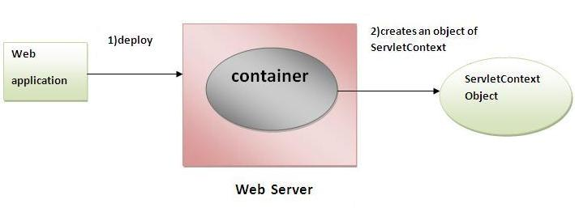
Cont.
The ServletContext object can be used to provide inter-application communication.

Slide 8
Cont.
used methods of ServletContext interface.
public String getInitParameter(String name):Returns the parameter value for the specified parameter name.
public Enumeration getInitParameterNames():Returns the names of the context's initialization parameters.
public void setAttribute(String name,Object object):sets the given object in the application scope.

Slide 9
Cont.
public Object getAttribute(String name):Returns the attribute for the specified name.
public void removeAttribute(String name):Removes the attribute with the given name from the servlet context.

Slide 10
HttpServletRequest Interface
Web server
creates an HttpServletRequest object
passes it to the servlet’s service method
HttpServletRequest object contains the request from the client

Slide 11
HttpServletRequest Interface (Cont.)

Slide 12
HttpServletResponse Interface
Web server
creates an HttpServletResponse object
passes it to the servlet’s service method

Slide 13
HttpServletResponse Interface (Cont.)

Slide 14
Session Tracking in Servlets
Session simply means a particular interval of time.
Session Tracking is a way to maintain state (data) of an user. It is also known as session management in servlet.
Http protocol is a stateless so we need to maintain state using session tracking techniques.

Slide 15
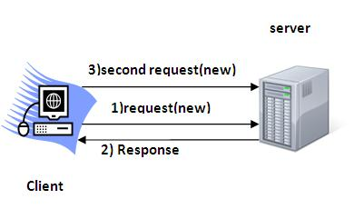
Cont.
Each time user requests to the server, server treats the request as the new request. So we need to maintain the state of an user to recognize to particular user.
HTTP is stateless that means each request is considered as the new request.

Slide 16
Cont.
Why use Session Tracking?
To recognize the user It is used to recognize the particular user.
Session Tracking Techniques
There are four techniques used in Session tracking:
Cookies
Hidden Form Field
URL Rewriting
HttpSession

Slide 17
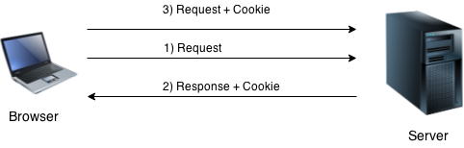
Cookies in Servlet
A cookie is a small piece of information that is persisted between the multiple client requests.
A cookie has a name, a single value, and optional attributes such as a comment, path and domain qualifiers, a maximum age, and a version number.

Slide 18
Cont.
How Cookie works??
By default, each request is considered as a new request.
In cookies technique, we add cookie with response from the servlet. So cookie is stored in the cache of the browser.
After that if request is sent by the user, cookie is added with request by default. Thus, we recognize the user as the old user.

Slide 19
Cont.
Types of Cookie
There are 2 types of cookies in servlets.
Non-persistent cookie
Persistent cookie
Non-persistent cookie
It is valid for single session only. It is removed each time when user closes the browser.
Persistent cookie
It is valid for multiple session . It is not removed each time when user closes the browser. It is removed only if user logout or signout.

Slide 20
Hidden Form Field
In case of Hidden Form Field a hidden (invisible) textfield is used for maintaining the state of an user.
In such case, we store the information in the hidden field and get it from another servlet. This approach is better if we have to submit form in all the pages and we don't want to depend on the browser.
<input type="hidden" name="uname" value="Vimal Jaiswal">

Slide 21
Cont.
Real application of hidden form field
It is widely used in comment form of a website. In such case, we store page id or page name in the hidden field so that each page can be uniquely identified.

Slide 22
Cont.
Advantage of Hidden Form Field
It will always work whether cookie is disabled or not.
Disadvantage of Hidden Form Field:
It is maintained at server side.
Extra form submission is required on each pages.
Only textual information can be used.

Slide 23
URL Rewriting
In URL rewriting, we append a token or identifier to the URL of the next Servlet or the next resource. We can send parameter name/value pairs using the following format:
url?name1=value1&name2=value2&??
A name and a value is separated using an equal = sign, a parameter name/value pair is separated from another parameter using the ampersand(&).
When the user clicks the hyperlink, the parameter name/value pairs will be passed to the server. From a Servlet, we can use getParameter() method to obtain a parameter value.

Slide 24
Cont.
Advantage of URL Rewriting
It will always work whether cookie is disabled or not (browser independent).
Extra form submission is not required on each pages.
Disadvantage of URL Rewriting
It will work only with links.
It can send Only textual information

Slide 25
HttpSession interface
In such case, container creates a session id for each user. The container uses this id to identify the particular user. An object of HttpSession can be used to perform two tasks:
bind objects
view and manipulate information about a session, such as the session identifier, creation time, and last accessed time.

Slide 26
Cont.
How to get the HttpSession object ?
The HttpServletRequest interface provides two methods to get the object of HttpSession:
public HttpSession getSession():Returns the current session associated with this request, or if the request does not have a session, creates one.
public HttpSession getSession(boolean create):Returns the current HttpSession associated with this request or, if there is no current session and create is true, returns a new session.

